Slide 1
Announcements
Project 3 thoughts:
Start today if you haven’t started yet. Not a project you can do last minute.
Slides and videos are available to help speed you through getting started.
Extra credit deadline is Friday. Covers only rastering.
The IntelliJ debugger is your friend. Make good use of it.

Slide 2

CS61B
Lecture 33: Sorting II: Quicksort
Backstory, Partitioning
Quicksort
Quicksort Performance Caveats and Conclusion

Slide 3
Backstory, Partitioning

Slide 4
Sorting So Far
Core ideas:
Selection sort: Find the smallest item and put it at the front.
Heapsort variant: Use MaxPQ to find max element and put at the back.
Merge sort: Merge two sorted halves into one sorted whole.
Insertion sort: Figure out where to insert the current item.
Quicksort:
Much stranger core idea: Partitioning.
Invented by Sir Tony Hoare in 1960, at the time a novice programmer.

Slide 5
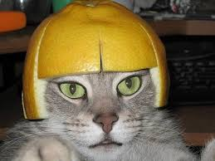
Context for Quicksort’s Invention (Source)
1960: Tony Hoare was working on a crude automated translation program for Russian and English.
How would you do this?
“The cat wore a beautiful hat.”
Binary search for each word.
Find “the” in log D time.
Find “cat” in log D time...
Total time: N log D
N words
... | ...
beautiful | красивая
... | ...
cat | кошка
... | ...
“Кошка носил красивая шапка.”
Dictionary of D english words
Notes:
Koshka nosil krasivaya shapka

Slide 6
Context for Quicksort’s Invention (Source)
1960: Tony Hoare was working on a crude automated translation program for Russian and English.
Algorithm: N binary searches of D length dictionary.
Total runtime: N log D
ASSUMES log time binary search!
... | ...
beautiful | красивая
... | ...
cat | кошка
... | ...
Limitation at the time:
Dictionary stored on long piece of tape, sentence is an array in RAM.
Binary search of tape is not log time (requires physical movement!).
Better: Sort the sentence and scan dictionary tape once. Takes N log N + D time.
But Tony had to figure out how to sort an array (without Google!)...

Slide 7
The Core Idea of Tony’s Sort: Partitioning
To partition an array a[] on element x=a[i] is to rearrange a[] so that:
x moves to position j (may be the same as i)
All entries to the left of x are <= x.
All entries to the right of x are >= x.
Called the ‘pivot’.
i
5
550
10
4
10
9
330
j
j
A.
4
5
9
10
10
330
550
B.
5
4
9
10
10
550
330
j
j
C.
5
9
10
4
10
550
330
D.
5
9
10
4
10
550
330
Which partitions are valid?

Slide 8
The Core Idea of Tony’s Sort: Partitioning
To partition an array a[] on element x=a[i] is to rearrange a[] so that:
x moves to position j (may be the same as i)
All entries to the left of x are <= x.
All entries to the right of x are >= x.
Called the ‘pivot’.
i
5
550
10
4
10
9
330
j
j
A.
4
5
9
10
10
330
550
B.
5
4
9
10
10
550
330
j
j
C.
5
9
10
4
10
550
330
D.
5
9
10
4
10
550
330
Which partitions are valid?

Slide 9
Interview Question (Partitioning)
Given an array of colors where the 0th element is white, and the remaining elements are red (less) or blue (greater), rearrange the array so that all red squares are to the left of the white square, and all blue squares are to the right. Your algorithm must complete in Θ(N) time (no space restriction).
Relative order of red and blues does NOT need to stay the same.
Input
6
8
3
1
2
7
4
Example of a valid output
Another example of a valid output
3
1
2
4
6
8
7
3
4
1
2
6
7
8

Slide 10
Interview Question, Student Answer #1
Given an array of colors where the 0th element is white, and the remaining elements are red (less) or blue (greater), rearrange the array so that all red squares are to the left of the white square, and all blue squares are to the right. Your algorithm must complete in Θ(N) time (no space restriction).
Relative order of red and blues does NOT need to stay the same.
Input
6
8
3
1
2
7
4
Algorithm: make an empty array. Iterate through items if blue, stick at the right end, if red, stick on left end.
3
1
2
4
6
7
8

Slide 11
Interview Question, Student Answer #1
Given an array of colors where the 0th element is white, and the remaining elements are red (less) or blue (greater), rearrange the array so that all red squares are to the left of the white square, and all blue squares are to the right. Your algorithm must complete in Θ(N) time (no space restriction).
Relative order of red and blues does NOT need to stay the same.
Input
6
8
3
1
2
7
4
Algorithm: Create a pointer to 6. If value is greater than 6, swap to the end of the array, scanning and swapping as you go… Uses no additional space! This algorithm is not fully described here, but typical implementations of partitioning are mor along thes elines.

Slide 12
Simplest (but not fastest) Answer: 3 Scan Approach
Given an array of colors where the 0th element is white, and the remaining elements are red (less) or blue (greater), rearrange the array so that all red squares are to the left of the white square, and all blue squares are to the right. Your algorithm must complete in Θ(N) time (no space restriction).
Relative order of red and blues does NOT need to stay the same.
Input
6
8
3
1
2
7
4
Algorithm: Create another array. Scan and copy all the red items to the first R spaces. Then scan for and copy the white item. Then scan and copy the blue items to the last B spaces.
Output
3
1
2
4
6
8
7

Slide 13
Quicksort

Slide 14
Partition Sort, a.k.a. Quicksort
5
3
2
1
7
8
4
6
Q: How would we use this operation for sorting?
3
2
1
4
5
7
8
6
Observations:
5 is “in its place.” Exactly where it’d be if the array were sorted.
Can sort two halves separately, e.g. through recursive use of partitioning.
3
2
1
4
5
5
7
8
6
2
1
3
4
5
5
6
7
8

Slide 15
Partition Sort, a.k.a. Quicksort
Quicksorting N items: (Demo)
Partition on leftmost item.
Quicksort left half.
Quicksort right half.
32
15
2
17
19
26
41
17
17
partition(32)
in its place
<= 32
>= 32
15
2
17
19
26
17
17
32
41

Slide 16
Quicksort
Quicksort was the name chosen by Tony Hoare for partition sort.
For most common situations, it is empirically the fastest sort.
Tony was lucky that the name was correct.
How fast is Quicksort? Need to count number and difficulty of partition operations.
Theoretical analysis:
Partitioning costs Θ(K) time, where Θ(K) is the number of elements being partitioned (as we saw in our earlier “interview question”).
The interesting twist: Overall runtime will depend crucially on where pivot ends up.
Notes:
Got here

Slide 17
Quicksort Runtime

Slide 18
Best Case: Pivot Always Lands in the Middle
Only size 1 problems remain, so we’re done.

Slide 19
Best Case Runtime?
Only size 1 problems remain, so we’re done.
What is the best case runtime?

Slide 20
Best Case Runtime?
Total work at each level:
≈ N
≈N/2 + ≈N/2 = ≈N
≈N/4 * 4 = ≈N
Only size 1 problems remain, so we’re done.
Overall runtime:
Θ(NH) where H = Θ(log N)
so: Θ(N log N)

Slide 21
Worst Case: Pivot Always Lands at Beginning of Array
Give an example of an array that would follow the pattern to the right.
What is the runtime Θ(∙)?

Slide 22
Worst Case: Pivot Always Lands at Beginning of Array
Give an example of an array that would follow the pattern to the right.
1 2 3 4 5 6
What is the runtime Θ(∙)?
N²

Slide 23
Quicksort Performance
Theoretical analysis:
Best case: Θ(N log N)
Worst case: Θ(N²)
Compare this to Mergesort.
Best case: Θ(N log N)
Worst case: Θ(N log N)
Recall that Θ(N log N) vs. Θ(N²) is a really big deal. So how can Quicksort be the fastest sort empirically? Because on average it is Θ(N log N).
Rigorous proof requires probability theory + calculus, but intuition + empirical analysis will hopefully convince you.

Slide 24
Argument #1: 10% Case
Suppose pivot always ends up at least 10% from either edge (not to scale).
N
N/10
9N/10
N/100
9N/100
9N/100
81N/100
Work at each level: O(N)
Runtime is O(NH).
H is approximately log _{10/9} N = O(log N)
Overall: O(N log N).
Punchline: Even if you are unlucky enough to have a pivot that never lands anywhere near the middle, but at least always 10% from the edge, runtime is still O(N log N).

Slide 25

Argument #2: Quicksort is BST Sort
5
3
2
1
7
8
4
6
5
3
2
1
4
5
7
8
6
3
7
2
1
3
4
5
6
7
8
2
4
6
8
1
Key idea: compareTo calls are same for BST insert and Quicksort.
Every number gets compared to 5 in both.
3 gets compared to only 1, 2, 4, and 5 in both.
Reminder: Random insertion into a BST takes O(N log N) time.

Slide 26
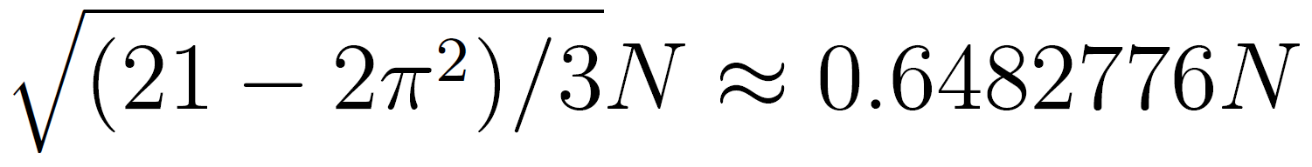
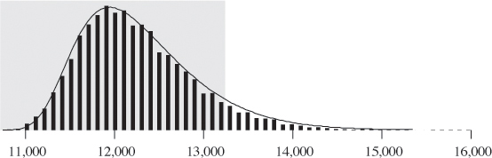
Empirical Quicksort Runtimes
For N items:
Mean number of compares to complete Quicksort: ~2N ln N
Standard deviation:
Lots of arrays take 12,000ish compares to sort with Quicksort.
A very small number take 15,000ish compares to sort with Quicksort.
Empirical histogram for quicksort compare counts (10,000 trials with N = 1000)
Chance of taking 1,000,000ish compares is effectively zero.
For more, see: http://www.informit.com/articles/article.aspx?p=2017754&seqNum=7

Slide 27
Quicksort Performance
Theoretical analysis:
Best case: Θ(N log N)
Worst case: Θ(N²)
Randomly chosen array case: Θ(N log N) expected
Compare this to Mergesort.
Best case: Θ(N log N)
Worst case: Θ(N log N)
Why is it faster than mergesort?
Requires empirical analysis. No obvious reason why.
For our pivot/partitioning strategies: Sorted or close to sorted.
With extremely high probability!!

Slide 28
Sorting Summary (so far)
Listed by mechanism:
Selection sort: Find the smallest item and put it at the front.
Insertion sort: Figure out where to insert the current item.
Merge sort: Merge two sorted halves into one sorted whole.
Partition (quick) sort: Partition items around a pivot.
Listed by memory and runtime:
 | Memory | Time | Notes
Heapsort | Θ(1) | Θ(N log N) | Bad caching (61C)
Insertion | Θ(1) | Θ(N²) | Θ(N) if almost sorted
Mergesort | Θ(N) | Θ(N log N)
Quicksort | Θ(log N) (call stack) | Θ(N log N) expected | Fastest sort

Slide 29
Avoiding the Quicksort Worst Case

Slide 30
Quicksort Performance
The performance of Quicksort (both order of growth and constant factors) depend critically on:
How you select your pivot.
How you partition around that pivot.
Other optimizations you might add to speed things up.
Bad choices can be very bad indeed, resulting in Θ(N²) runtimes.
Notes:
Akin to saying: Do we need to worry about internet posts advocating mass murder? Most random pieces of text are not about mass murder and in fact contain no semantic content at all.

Slide 31
Avoiding the Worst Case
If pivot always lands somewhere “good”, Quicksort is Θ(N log N). However, the very rare Θ(N²) cases do happen in practice, e.g.
Bad ordering: Array already in sorted order (or almost sorted order).
Bad elements: Array with all duplicates.
What can we do to avoid worst case behavior?
Recall, our version of Quicksort has the following properties:
Leftmost item is always chosen as the pivot.
Our partitioning algorithm preserves the relative order of <= and >= items.
6
8
3
1
2
7
4
3
1
2
4
6
8
7

Slide 32
Avoiding the Worst Case: My Answers
What can we do to avoid running into the worst case for QuickSort?
Four philosophies:
1. Randomness: Pick a random pivot or shuffle before sorting.
2. Smarter pivot selection: Calculate or approximate the median.
3. Introspection: Switch to a safer sort if recursion goes to deep.
4. Preprocess the array: Could analyze array to see if Quicksort will be slow. No obvious way to do this, though (can’t just check if array is sorted, almost sorted arrays are almost slow).

Slide 33

Philosophy 1: Randomness (My Preferred Approach)
If pivot always lands somewhere “good”, Quicksort is Θ(N log N). However, the very rare Θ(N²) cases do happen in practice, e.g.
Bad ordering: Array already in sorted order.
Bad elements: Array with all duplicates.
Dealing with bad ordering:
Strategy #1: Pick pivots randomly.
Strategy #2: Shuffle before you sort.
The second strategy requires care in partitioning code to avoid Θ(N²) behavior on arrays of duplicates.
Common bug in textbooks! See A level problems.

Slide 34

Philosophy 2a: Smarter Pivot Selection (constant time pivot pick)
Randomness is necessary for best Quicksort performance! For any pivot selection procedure that is:
Deterministic
Constant Time
The resulting Quicksort has a family of dangerous inputs that an adversary could easily generate.
See McIlroy’s “A Killer Adversary for Quicksort”
7
2
3
4
5
6
1
8
Dangerous input
Notes:
https://i.ytimg.com/vi/lEF3SPhz5Q8/maxresdefault.jpg

Slide 35
Philosophy 2b: Smarter Pivot Selection (linear time pivot pick)
Could calculate the actual median in linear time.
“Exact median Quicksort” is safe: Worst case Θ(N log N), but it is slower than Mergesort.
Raises interesting question though: How do you compute the median of an array? Will talk about how to do this next lecture.
Notes:
https://i.ytimg.com/vi/lEF3SPhz5Q8/maxresdefault.jpg

Slide 36
Philosophy 3: Introspection
Can also simply watch your recursion depth.
If it exceeds some critical value (say 10 ln N), switch to mergesort.
Perfectly reasonable approach, though not super common in practice.

Slide 37
Sorting Summary (so far)
Listed by mechanism:
Selection sort: Find the smallest item and put it at the front.
Insertion sort: Figure out where to insert the current item.
Merge sort: Merge two sorted halves into one sorted whole.
Partition (quick) sort: Partition items around a pivot.
Next time: Alternate strategy for partitioning, pivot identification.
Listed by memory and runtime:
 | Memory | Time | Notes
Heapsort | Θ(1) | Θ(N log N) | Bad caching (61C)
Insertion | Θ(1) | Θ(N²) | Θ(N) if almost sorted
Mergesort | Θ(N) | Θ(N log N)
Random Quicksort | Θ(log N) (call stack) | Θ(N log N) expected | Fastest sort

Slide 38
Citations
Quickman from Mega Man 2

Slide 39
Deleted Slides

Slide 40
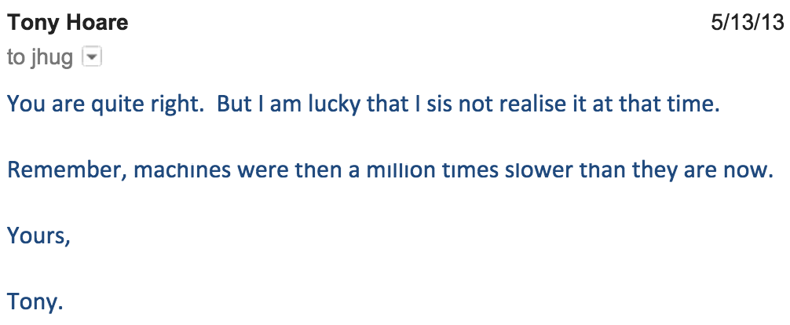
More Quicksort Origins
Amusingly, Quicksort was the wrong tool for the job. Two issues:
Language that Tony was using didn’t support recursion (so he couldn’t easily implement Quicksort).
Sentences are usually shorter than 15 words.

Slide 41
Citations
Quickman from Mega Man 2

